Slide 1
topicEleven
JavaScript Essentials

Slide 2
Learning Objectives
At the end of this chapter the students should be able to:
Understand the difference between HTML and JavaScript
Understand how the browser recognize and handle JavaScript
Understand the basic syntax of JavaScript
Understand the different functions of JavaScript

Slide 3
Introduction
JavaScript is a scripting language that was design to add programming functions into your standard HTML web pages.
It can help you to collect information regarding web visitors, setting up page counter and much more.
JavaScript is a client-side scripting.
It can be written either internally or externally

Slide 4
Other functions of JavaScript are:
Browser Detection
You can use JavaScript to detect the type of browser used by a visitor at your page. Some web pages work well under certain kind of browsers
Cookies
Cookies are essential in any programming code because it can be used as an indicator for a certain record and to store information on the visitor's computer. The value of the cookies can be anything, from username to time, date, personal id and etc.
Control Browsers
JavaScript can be used to open pages in customized windows, where you can specify if the browser's buttons, menu line, status line or whatever should be present.
Validate Forms
Each form must be validate before it can be processed, in order to prevent visitors from entering empty or wrong character in the form. An example would be validating the entered email address to see if it has a @ in it, since if not, it's not a valid address.

Slide 5
Using JavaScript
JavaScript isn’t a HTML file, so how does the browser recognize it?
In order to process the JavaScript, you will need to let the browser know in advance when you enter JavaScript to an HTML page.
This is done using the <script> tag.
The browser will use the <script type="text/javascript"> and </script> to tell where JavaScript starts and ends.

Slide 6
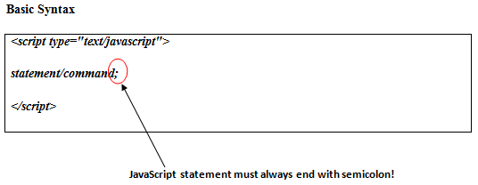

Slide 7
Using JavaScript
By entering the command/statement between the <script type="text/javascript"> and </script> tags, it will help the browser to recognize it as a JavaScript command.
If we had not entered the <script> tags, the browser would simply recognize it as pure text, and just write it on the screen.
You are permitted to enter JavaScript in both the <head> and <body> sections of the document.
However, it is advisable to keep as much as possible in the <head> section.
Besides that, you could also use JavaScript in both (Head+body) and external JavaScript.

Slide 8
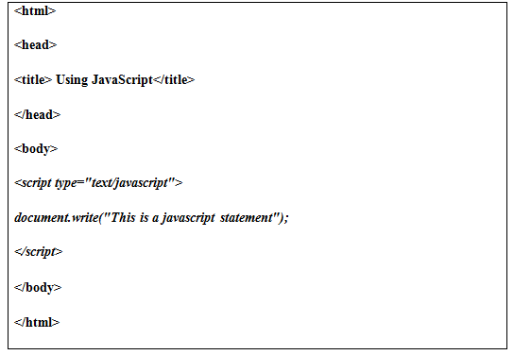

Slide 9
JavaScript Rules
Must always end with semicolon.
You may have noticed from the example on the previous page that JavaScript lines end with a semicolon. Failing to end it with semicolon will generate a script error and your JavaScript will not be functioning. You can write the code in a single line as long as it is separated by semicolon, but it’s not advisable.
Always put the text within " ".
When entering text to be handled by JavaScript, you should always put the text within " " bracket. Filing to do so will resulting JavaScript to interpret your text as being variables rather than text.
Case sensitive.
JavaScript is case-sensitive programming language. You should always remember that capital letters are different from lowercase letters.

Slide 10
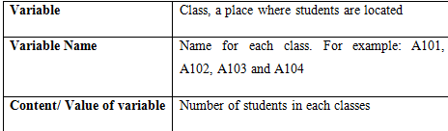
Variables
A variable is simply a place in the computer's memory to store information.
All variables are referred to by the unique name you assigned to them.
Variables can be compared to a classroom full with students.
Let’s say that we have four (4) classrooms, each classroom comprises of 25 students. We can summarize that:

Slide 11
Assigning value to variable
The most common way to assign a value to a variable is using the equals sign.
Variable is a case sensitive.
For example, myVar is different with MyVar.
Even though the mistake is minimal, the JavaScript will consider that it’s a different kind of variables

Slide 12
Some of the way to assigning values is:
Value Assignment | Result (as printed in web pages)
MyVar= 100; | 100
MyVar=100; MyVar++; | 101
MyVar=100; MyVar--; | 99
MyVar=5; a=MyVar-5; | 0
MyVar=5; a=MyVar+5; | 10
Name1= “Malik”; | Malik
Name2= “Aziz”; | Aziz
Name3=Name1+“ “+Name2; | Malik Aziz
a=4*3; | 12
d=12/4; | 3
e=(1+3)*4; | 16

Slide 13
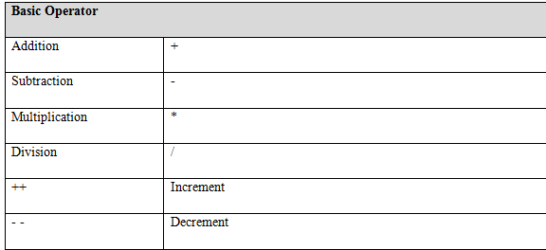

Slide 14
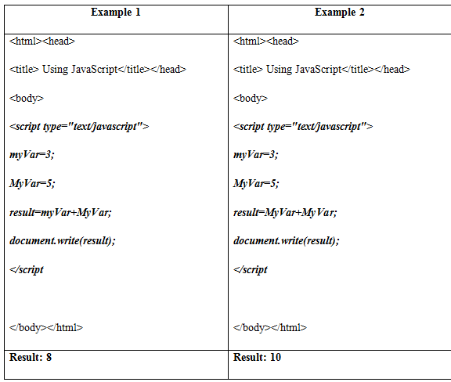

Slide 15
Choosing Right Syntax
The best advice is to use the same syntax on all variables.
Either write all variables in small letters, start with one capital letter or write all variables in capitals.
Which syntax you chose is not important - as long as you chose just one.
For example, you could capitalize each of the variables or using a particular jargon to representing each element, such as int for Integer, txt for text and etc.

Slide 16
Concatenation
The + operator can be used to add string variables or text values together. For example:
varFname= “Rahimi”;
varLName= “Rosman”;
varFullName= varFname + varLName;

Slide 17
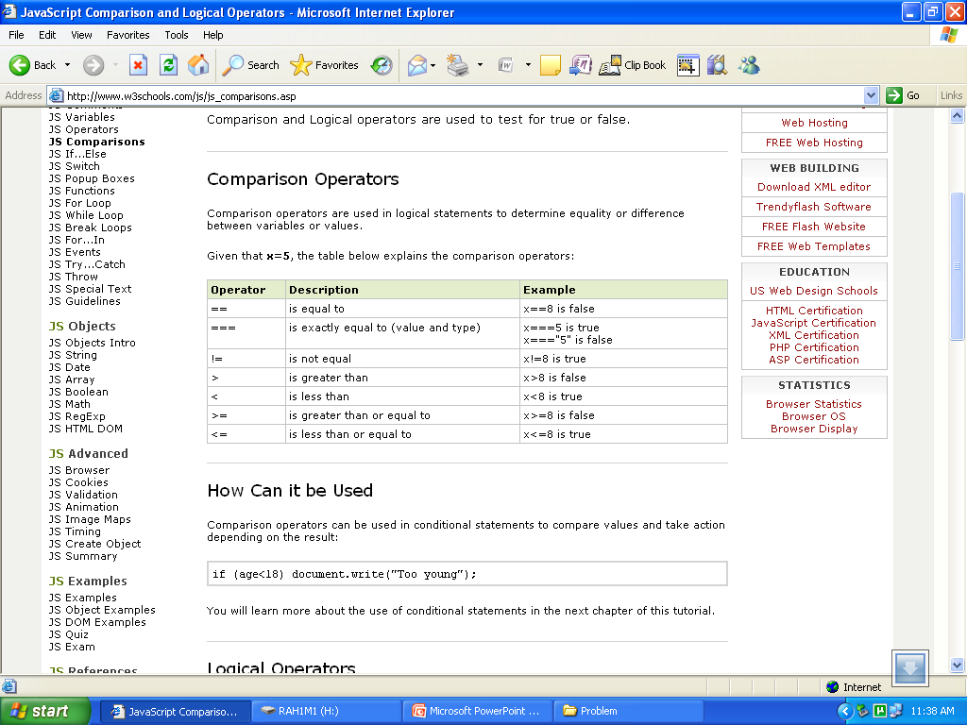
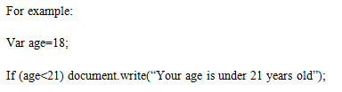
Comparison Operator
Comparison operator is used in logical statement to determine equality or difference between variables or values.

Slide 18
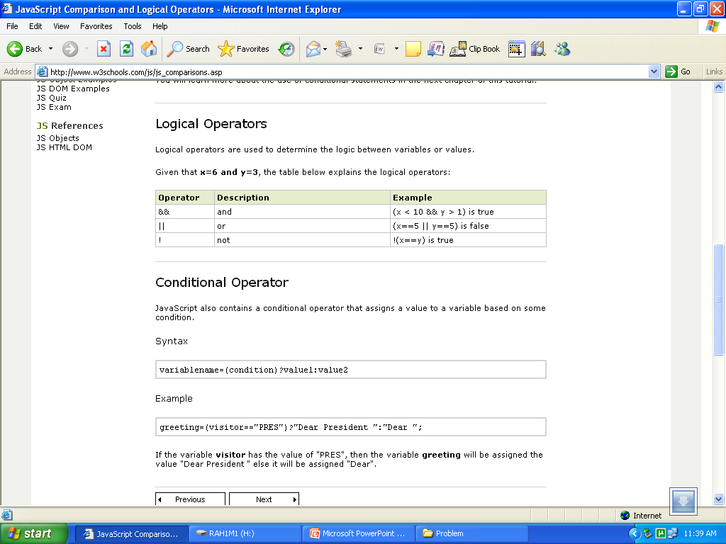
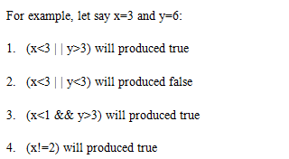
Logical Operator
Logical operator is used to determine the logic between values and variables.

Slide 19
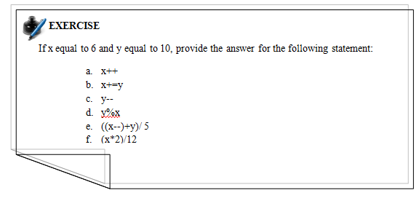

Slide 20
Conditional statement
Conditional statement is used to perform a different action for a different decision. There are three types of conditional statement:
If statement – execute some code if condition is true
If..else statement - execute some code if condition is true and another if condition is false
If…else if…else statement – used this statement to select one of many code to be executed
Switch statement - used this statement to select one of many code to be executed

Slide 21
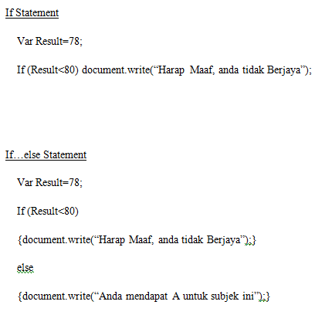

Slide 22
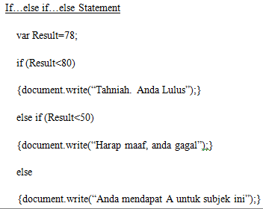

Slide 23
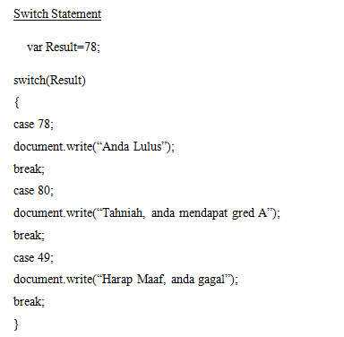

Slide 24
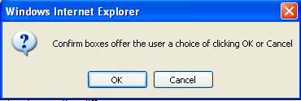
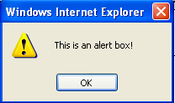

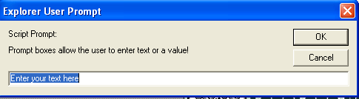
JavaScript: Pop Up Boxes

Slide 25
JavaScript: Alert Box
The syntax for an alert box is: alert("yourtext");
The user will need to click "OK" to proceed.
Typical use is when you want to make sure information comes through to the user.
Examples could be warnings of any kind. (Typical examples are "Adult Content", or technical matters like "This site requires Shockwave Flash plug-in").

Slide 26

JavaScript: Confirm Box
The syntax for a confirm box is: confirm("yourtext");
The user needs to click either "OK" or "Cancel" to proceed.
Typical use is when you want the user to verify or accept something.
Examples could be age verification like "Confirm that you are at least 57 years old" or technical matters like "Do you have a plug-in for Shockwave Flash?“
If the user clicks "OK", the box returns the value true.
If the user clicks "Cancel", the box returns the value false

Slide 27

JavaScript: Prompt Box
The prompt box syntax is: prompt("yourtext","defaultvalue");
The user must click either "OK" or "Cancel" to proceed after entering the text.
Typical use is when the user should input a value before entering the page.
Examples could be entering user's name to be stored in a cookie or entering a password or code of some kind.
If the user clicks "OK" the prompt box returns the entry.
If the user clicks "Cancel" the prompt box returns null.
Since you usually want to use the input from the prompt box for some purpose it is normal to store the input in a variable:

Slide 28
JavaScript: Example 1 (alert)
<html>
<head><title>Alert Box</title>
<script type="text/javascript">
alert("Selamat datang ke website saya");
</script>
</head>
<body>
</body>
</html>

Slide 29
JavaScript: Example 2 (prompt)
<html>
<head><title>Prompt Box</title>
<script type="text/javascript">
pengguna=prompt("Masukan Nama Anda","Nama Anda");
</script></head>
<body>
Selamat datang ke website ini,
<script type="text/javascript">
document.write (pengguna);
</script><br>
Umur anda: <br>
Tarikh Lahir:<br>
email:<br>
</body>
</html>

Slide 30
JavaScript: Example 3(Confirm)
<html>
<head><title>Confirm Box</title></head>
<body>
<script type="text/javascript">
pengguna=confirm("Adakah anda Mahasiswa/i IS110?");
if (pengguna==true)
{
document.write ("Selamat datang ke Website <a href='http://is110.official.ws'>Image</a>");
}
else
{
document.write ("Maaf, website ini hanya untuk student IS110 sahaja");
}
</script>
</body>
</html>

Slide 31
A Taste Of Javascript
Many of the most popular effects created on Web pages these days have little or nothing to do with HTML and everything to do with JavaScript, a scripting language originally developed by Netscape Communications and now supported by all major browsers.
This topic will discuss a sampler of very simple scripts.
Hopefully, they will give you the beginning of an idea of what you can do with JavaScript

Slide 32
Adding the Current Date and Time
Nothing makes your page seem more current than adding the date and the time.
While they're a bit more complicated to format in a particular way, just adding them is not difficult at all.
To add the current date and time to your page:

Slide 33
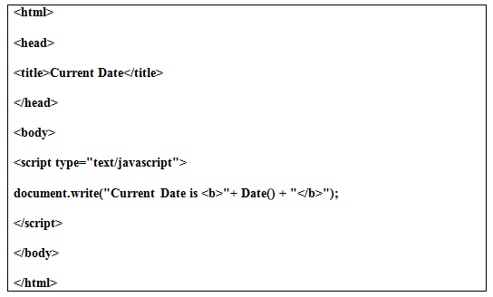

Slide 34
Setting a New Window's Size
Previously you have learned how to open a link in a new window.
JavaScript lets you control how big that window should be.

Slide 35
To set the size of a new window:
Type <a href="javascript:location='current.html';, where current.html is the URL of the page that contains the link.
Type window.open('nextpage.html', where nextpage.html is the URL of the page to be opened in the new window.
Type 'label', where label is the name of the new window.
Type 'height=h,width=w, where h and w are the desired height and width for the new window. (No spaces!)
If desired, type ,chrome=yes, where chrome is scrollbars, toolbar, status, menubar, location, or resizable.
If desired, type a, (comma) and repeat step 5 as desired. Each window part should be separated from the previous one with a comma but no spaces.
Type ' (a straight apostrophe)whether or not you've set the window parts.
Type )" to finish the JavaScript code.
Type >clickable text</a>.

Slide 36
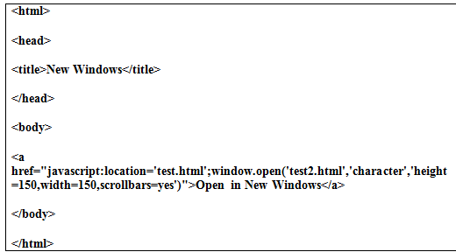

Slide 37
Changing an Image When a Visitor Points
You can make an image change when the visitor points at it.
This is commonly called a "rollover". To change an image when the visitor points at it:

Slide 38
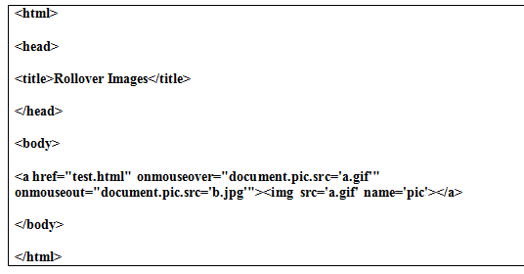
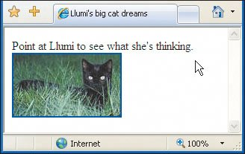

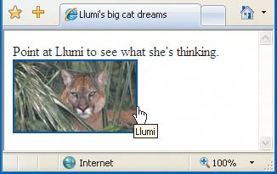

Slide 39
Changing a Link’s Status Label
<html><head>
<title>Link Status</title>
</head>
<body>
<img src="a.gif" alt="Big Bang Theory" align="left" width="384" height="256" border="0" hspace="5" vspace="0" onmouseover="window.status='Sun to earth'; return true" onmouseout="window.status='Testing'; return true" />
</body>
</html>

Slide 40
Changing Multiple Frames with One Link
<!DOCTYPE html PUBLIC "-//W3C//DTD XHTML 1.0 Transitional//EN"
"http://www.w3.org/TR/xhtml1/DTD/xhtml1-transitional.dtd">
<html xmlns="http://www.w3.org/1999/xhtml">
<head>
<meta http-equiv="content-type" content="text/html; charset=iso-8859-1" />
<meta http-equiv="Content-Script-Type" content="text/javascript" />
<title>Table of Contents</title>
</head>
<body>
<h1>Wild Animals</h1>
<br />
<a
href="javascript:location='toc.html';parent.topright.location='birdbuttons.html';parent.bottomright.location='parrots.html'">
Birds</a> <br />
</body></html>

Slide 41
Loading Images into Cache
You can use JavaScript to load all of the images into your browser's cache as the page is initially displayed on the screen.
One benefit is that rollovers are instantaneous

Slide 42
To load images into cache:
In a separate text document, on the first line, type label=, where label is a word that identifies the image.
Type new Image(h,w), where h and w are the image's height and width, in pixels.
On the next line, type label, where label matches the label used in step 1.
Directly following the name in step 3 (i.e., with no extra spaces), type .src="image.url", where image.url is the location of the image on the server.
Repeat steps 1-4 for each image you wish to load into cache
Save the script in text-only format and call it loadimages.js.
In the head section of the (X)HTML document that uses the images, type <script type="text/javascript" language="javascript" src="loadimages.js"> </script>, where loadimages.js is the name of the file you saved in step 6.
When you refer to the images in other scripts, use label.src (without quotes), where label is the word you used to describe the images in step 1

Slide 43
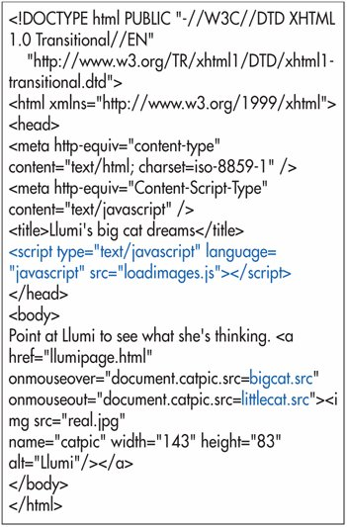
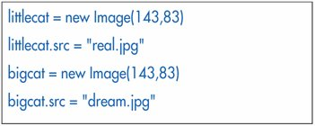

Slide 44
Exercise
Create a simple JavaScript statement that request a number from visitors. The script should check whether the number is an odd or even number. The result will be display in an alert box.

Slide 45
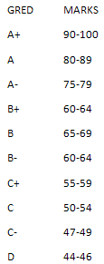
Exercise
Convert the following table into a JavaScript statement by using if functions.
The student marks will be inputted using the prompt box and the result will be displayed in the body of the documents.
Alert box will appear if the input greater than 100

Slide 46
Exercise
Create a script that request initial loan, interest, payback period, and display the data in the document alongside expected monthly payment.

Slide 47
Exercise
Create a JavaScript statement that request 2 input from user (page title and background color/picture) and display it on the screen.

